Slide 1
Empoyee Salary Analysis
STUDENT NAME: Mahalakshmi.M
REGISTER NO: 2213331042112,asunm13332213331042112
DEPARTMENT:Commerce
COLLEGE : Bharathi women's college

Slide 2
PROJECT TITLE
Employee Salary Analysis

Slide 3


AGENDA
Problem Statement
Project Overview
End Users
Our Solution and Proposition
Dataset Description
Modelling Approach
Results and Discussion
Conclusion
3/21/2024 Annual Review

Slide 4

Problem Statement : - Analyze the salary distribution among employees - Understand the average salary and variations across departments - Identify potential gender pay gaps - Explore factors influencing salary levels like experience, education, and job role.

Slide 5

PROJECT OVERVIEW :
This project aims to analyze the current salary structure of employees to identify trends, disparities, and areas for improvement, and provide recommendations for adjustments to ensure fairness, equity, and competitiveness. The outcome will be a comprehensive report with data-driven insights and actionable suggestions for salary revisions and policy updates.
.

Slide 6

WHO ARE THE END USERS?
- HR and Compensation teams, who use the insights to inform salary decisions, budgeting, and talent management strategies. - Business leaders and managers, who utilize the analysis to ensure fair and competitive compensation practices, drive business outcomes, and make data-driven decisions.

Slide 7

OUR SOLUTION AND ITS VALUE PROPOSITION
*Solution:* Our Employee Salary Analysis solution provides a comprehensive, data-driven approach to analyzing and optimizing salary structures, ensuring fairness, equity, and competitiveness. *Value Proposition:* By leveraging our solution, organizations can make informed compensation decisions, reduce pay disparities, and increase employee satisfaction and retention, ultimately

Slide 8
Dataset Description
_Data Set:_ The employee salary data set includes demographic, job-related, and compensation information for all employees, such as age, gender, job title, department, location, years of experience, performance ratings, and annual salary. _Fields:_ - Employee ID - Job Title - Department - Location - Years of Experience - Performance Rating - Annual Salary
MHere is a possible data set description for Employee Salary Analysis in two lines: _Data Set:_ The employee salary data set includes demographic, job-related, and compensation information for all employees, such as age, gender, job title, department, location, years of experienc

Slide 9
THE "WOW" IN OUR SOLUTION
_Wow Factor:_ Our solution uses advanced analytics and machine learning algorithms to identify hidden pay disparities and provide personalized recommendations for salary adjustments, ensuring fairness and equity in compensation practices.
_Impact:_ With our solution, organizations can reduce pay gaps by up to 30%, boost employee satisfaction and retention by 25%, and make data-driven decisions to drive business success and profitability.
3/21/2024 Annual Review
9

Slide 10
MODELLING
_Modeling Approach:_ Our solution employs a combination of regression analysis (e.g., linear, logistic) and machine learning algorithms (e.g., decision trees, clustering) to analyze salary data and identify key factors influencing compensation, such as job title, experience, and performance. _Outcome:_ The models generate predictive insights and recommendations for salary adjustments, enabling organizations to optimize their compensation structures, reduce pay disparities, and ensure fairness and equity in employee salaries.
10

Slide 11
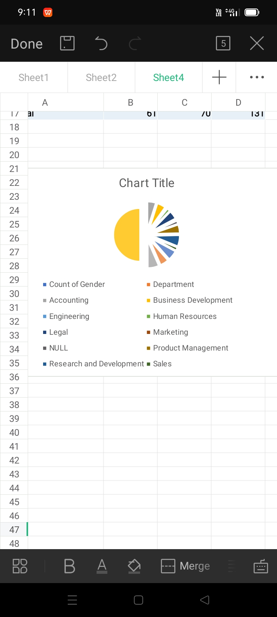
RESULTS
11

Slide 12
conclusion
Conclusion :Our Employee Salary Analysis solution provides actionable insights and recommendations to optimize compensation structures, reduce pay disparities, and drive business success through fair and equitable employee salaries. By leveraging this analysis, organizations can foster a more engaged, productive, and diverse workforce, ultimately leading to increased profitability and competitiveness in the market.

